Slide 1
Question Statement: “Display network statistics information in a human readable form”
Elsa Thomas, Emmanuel Jojy, Femy Mangaly, Gary Varkey

Slide 2
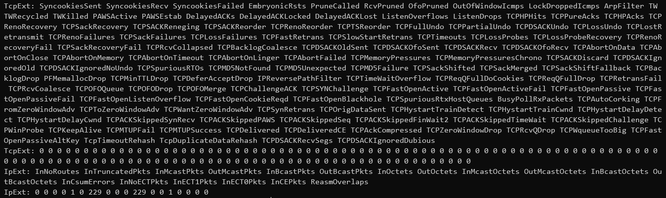
cat /proc/net/netstat

Slide 3
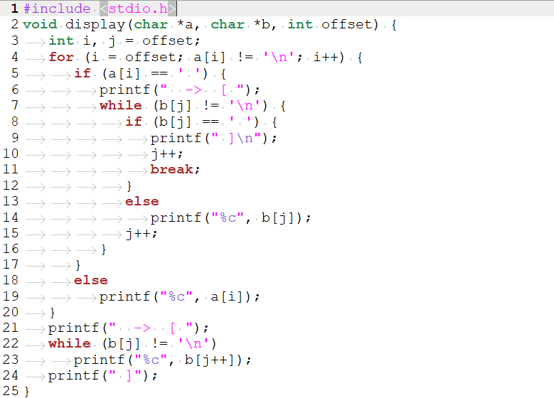
Source Code - 1

Slide 4
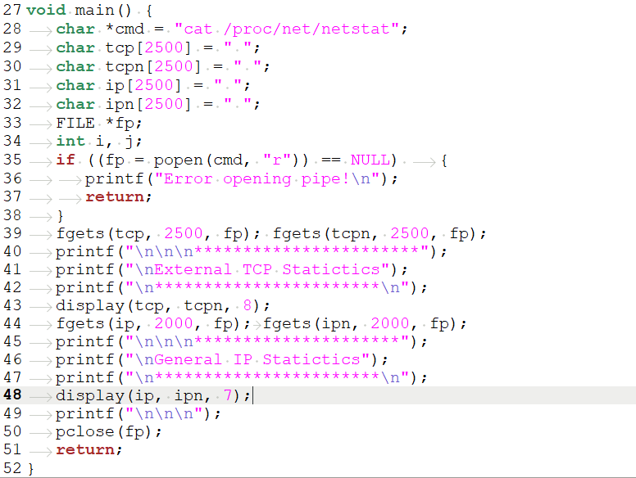
Source Code - 2

Slide 5
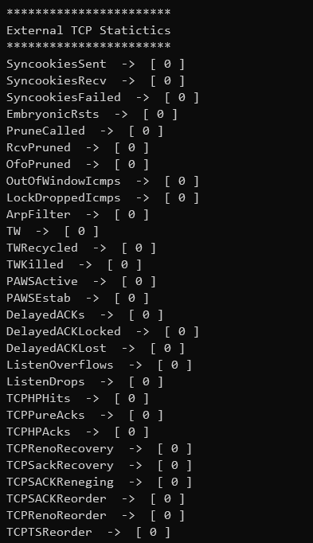
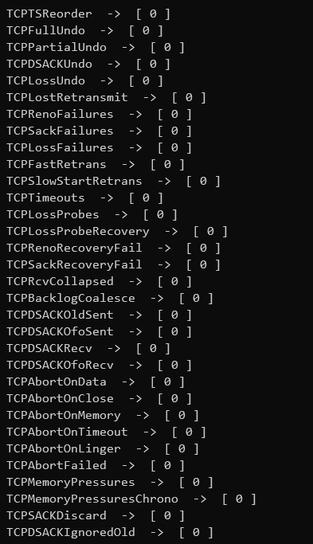
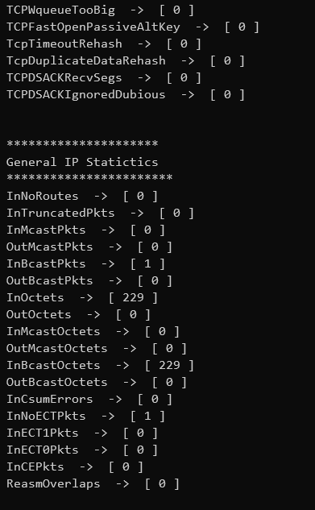
Output

Slide 6
Commands Used
FILE *popen(char *cmd)
System call that creates a pipe stream between the program process and the command process.
int fgets(char *, int noOfCharacters, FILE *fp)
To read the required number of characters from the fp and store into a character array
int pclose(FILE *fp)
System call that closes an open pipe.

Slide 7
Thank You

